Slide 1
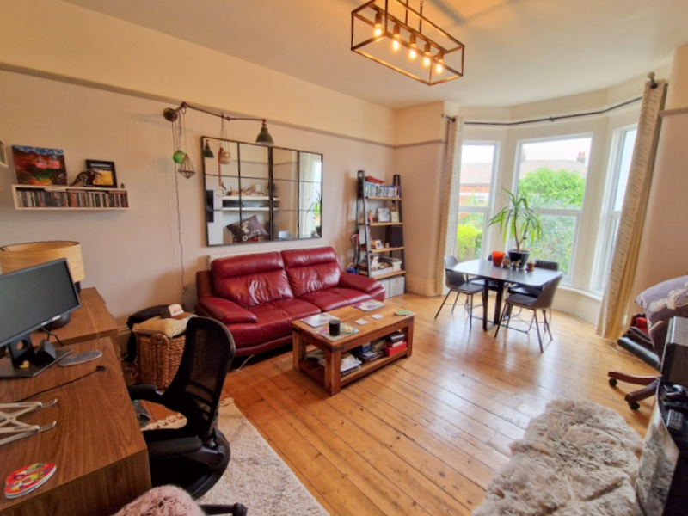
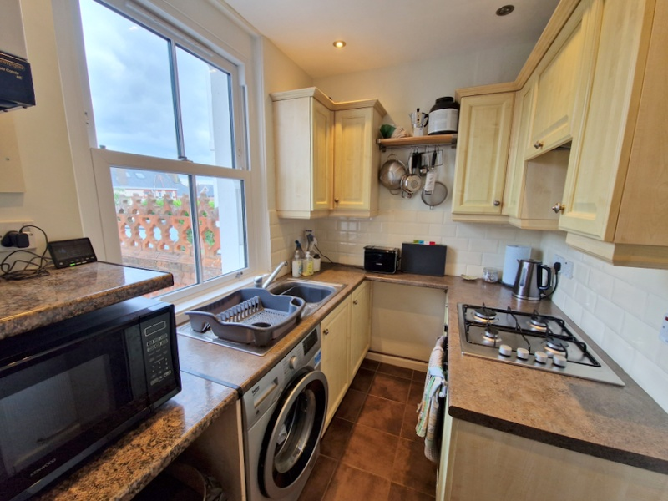
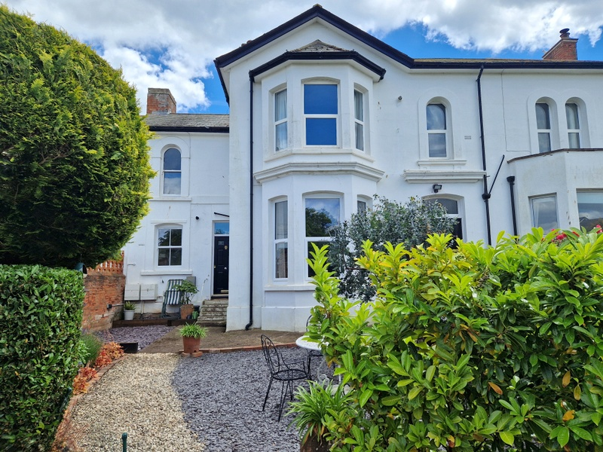
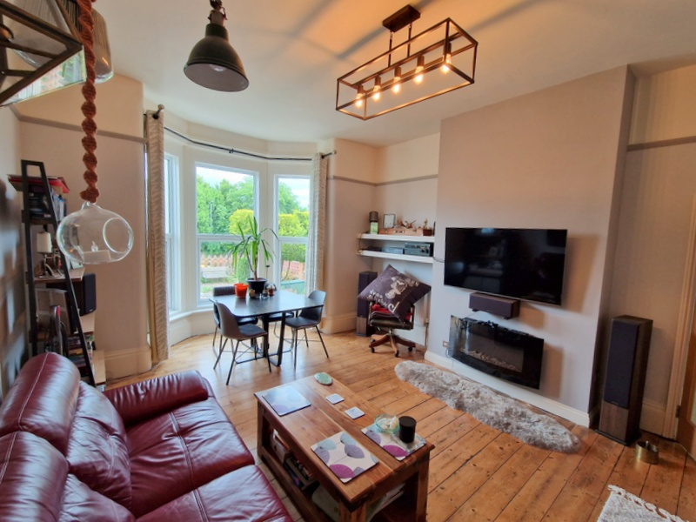
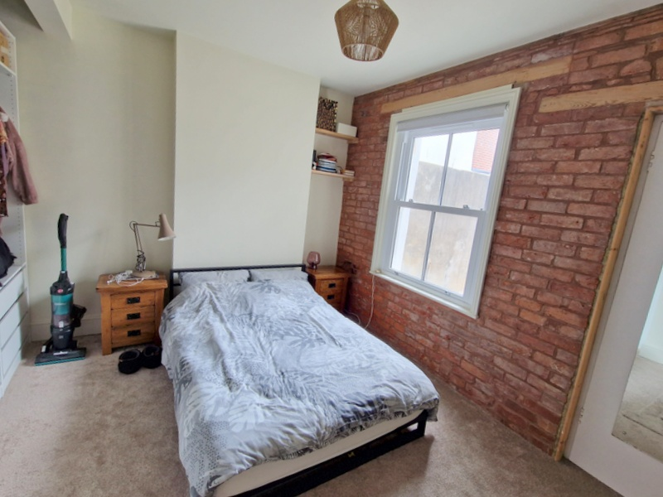
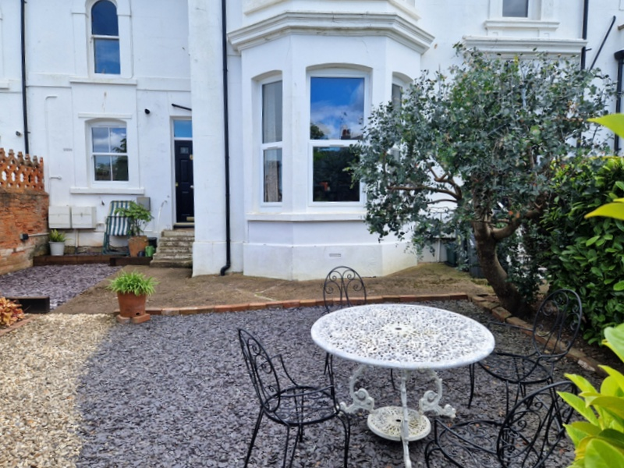
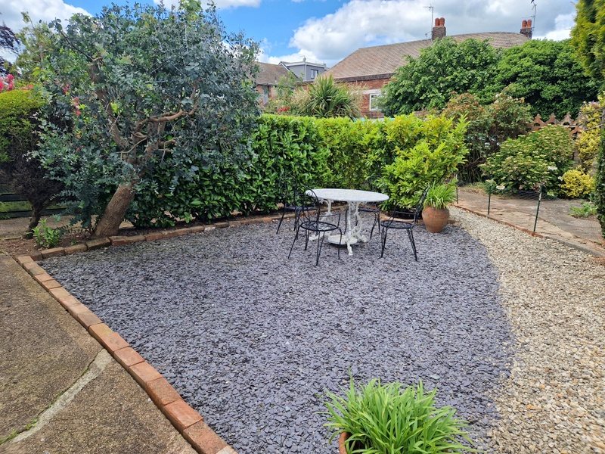
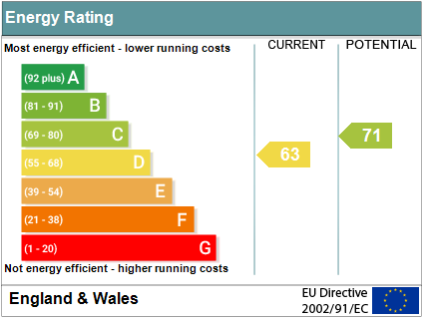
www.pennys.net
Flat 1, 3 Dagmar Road, Exmouth, EX8 2AN
GUIDE PRICE £225,000
TENURE Leasehold
Self Contained Ground Floor Apartment Enjoying A Town Centre Location With Its Own Private Garden
Private Entrance * Reception Hall * Spacious And Elegant Lounge/Dining Room * Separate Kitchen * Double Bedroom * En-Suite Modern Bathroom/Wc * Gas Central Heating * Double Glazed Windows * Viewing Strongly Recommended
Pennys Estate Agents Limited for themselves and for the vendor of this property whose agents they are give notice that:- (1) These particulars do not constitute any part of an offer or a contract. (2) All statements contained in these particulars are made without responsibility on the part of Pennys Estate Agents Limited. (3) None of the statements contained in these particulars are to be relied upon as a statement or representation of fact. (4) Any intending purchaser must satisfy himself/herself by inspection or otherwise as to the correctness of each of the statements contained in these particulars. (5) The vendor does not make or give and neither do Pennys Estate Agents Limited nor any person in their employment has any authority to make or give any representation or warranty whatever in relation to this property.
PENNYS ESTATE AGENTS
2 Rolle House, Rolle Street, Exmouth, Devon, EX8 2SN
Tel: 01395 264111 EMail: help@pennys.net

Slide 2
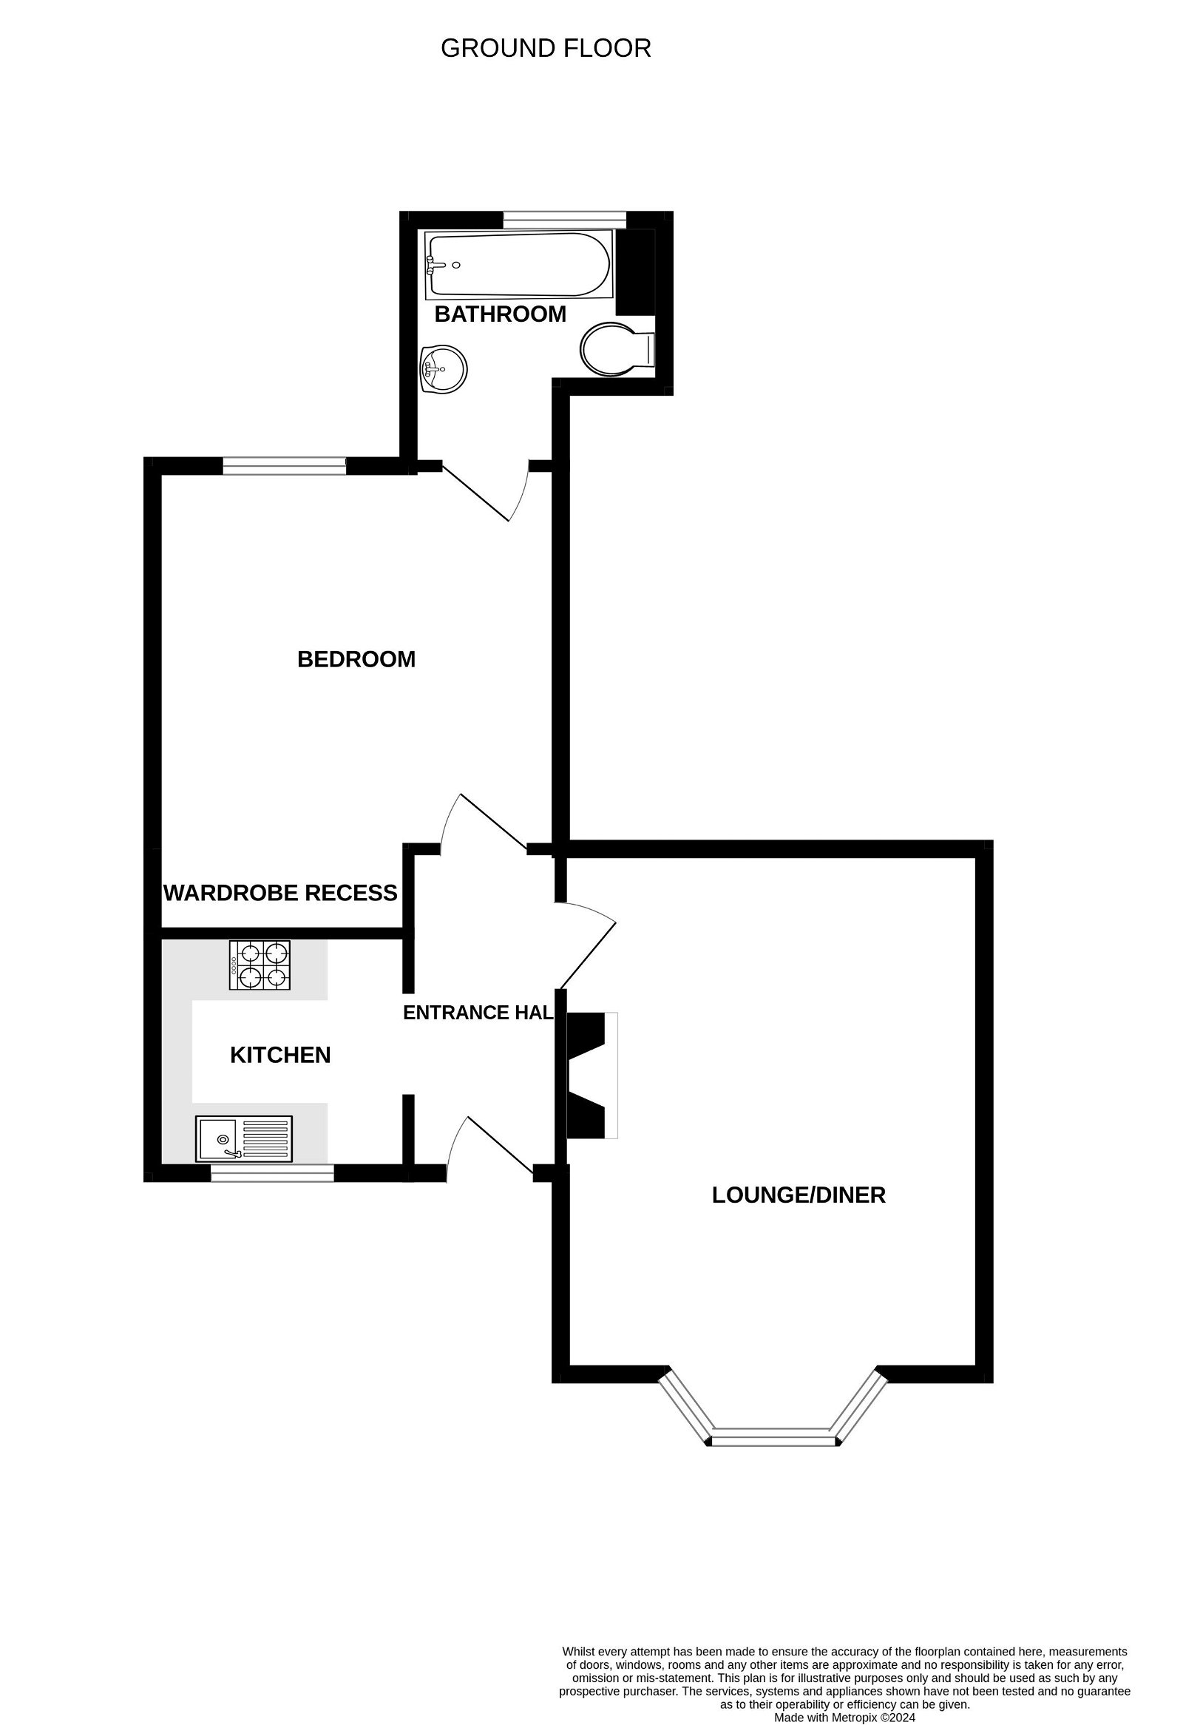
Flat 1, 3 Dagmar Road, Exmouth, EX8 2AN
THE ACCOMMODATION COMPRISESA private composite front door giving access to:
RECEPTION HALL: Radiator, coat rack, electric consumer unit, recessed ceiling LED spotlighting, wood laminate flooring, glazed panelled door to:
LOUNGE/DINING ROOM: 5.89m x 4.24m (19'4" x 13'11") A most spacious and elegant room with measurement into uPVC double glazed bay window which overlooks the front elevation and private garden, stripped wood flooring, wall mounted living flame fire, TV point, two radiators, picture rail.
KITCHEN: 2.54m x 1.75m (8'4" x 5'9") Fitted with pattern worktops with cupboards, drawer units, plumbing for automatic washing machine beneath worktops, inset single drainer sink unit with mixer tap, built-in oven with four ring gas hob over, extractor hood over, tiled surrounds, wall mounted cupboards, tiled flooring, uPVC sash style window looking over the front aspect in private gardens, wall mounted gas boiler for hot water and central heating. Wall recess currently housing upright fridge/freezer.
BEDROOM: 3.96m x 2.67m (13'0" x 8'9") plus large wall recess, ideal for fitted wardrobes. Feature exposed brick wall, TV point.
BATHROOM/WC: 2.13m x 2.08m (7'0" x 6'10") Stylishly fitted with modern suite with bath having Mira shower over, shower splash screen in attractive tiled surrounds, vanity style wash hand basin with mixer tap, cupboards beneath, tiled splashbacks and fitted mirror over, WC with push button flush, heated towel rail, coloured coordinated tiled flooring, uPVC double glazed window with patterned glass.
OUTSIDE: The property enjoys its own privately owned garden, which is beautifully planned offering an array of colour from mature shrub flower and shrub beds with large decorative stone/chipping areas, ideal for outside entertaining. Outside power sockets, outside cold water tap.
TENURE & OUTGOINGS: 100 year lease from 25th March 2018. Service Charge: £100 per month. Ground Rent: 150 per annum. Council Tax Band: B
FLOOR PLAN:

